Slide 1
Cloud Elevate –Exam Readiness workshop AWS Certified Developer - Associate
Developing and Deepening
Cloud skills @ATCI

Slide 2
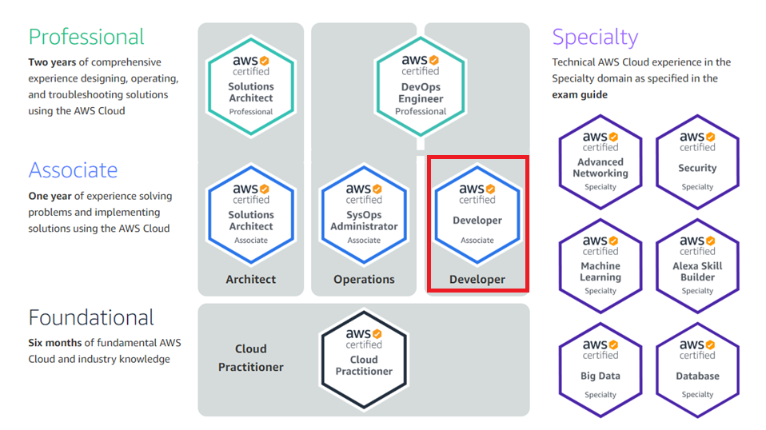
AWS CERTIFICATION PATH
https://aws.amazon.com/certification/
2

Slide 3
AWS Developer - associate
AWS Developer - Associate Exam Guide (Exam Blueprint)
Domain | % of Exam
1: Deployment | 22%
2: Security | 26%
3: Development with AWS | 30%
4: Refactoring | 10%
5: Monitoring and Troubleshooting | 12%
Total | 100%

Slide 4
Security– 26%
Objectives
Make authenticated calls to AWS
Implement encryption using AWS
Implement application authentication and authorization

Slide 5
Security – 26%
Key AWS Services
AWS Security Shared Responsibility Model
AWS IAM
AWS KMS
AWS Certificate Manager
AWS Secrets Manager
AWS VPC

Slide 6
AWS Shared Responsibility Model
RESPONSIBLE FOR SECURITY
IN THE CLOUD
CUSTOMER DATA
PLATFORM, APPLICATIONS, IDENTITY & ACCESS MANAGEMENT
CUSTOMERS
OPERATING SYSTEM, NETWORK & FIREWALL CONFIGURATION
CLIENT-SIDE DATA ENCRYPTION & DATA INTEGRITY AUTHENTICATION
SERVER-SIDE ENCRYPTION (FILE SYSTEM AND/OR DATA)
NETWORK TRAFFIC PROTECTION (ENCRYPTION/INTEGRITY/IDENTITY)
RESPONSIBLE FOR SECURITY
OF THE CLOUD
COMPUTE
STORAGE
DATABASE
NETWORKING
AWS
AWS GLOBAL INFRASTRUCTURE
REGIONS
EDGE LOCATIONS
AVAILABILITY ZONES

Slide 7













AWS security services
AWS IAM
Amazon
Cloud Directory
AWS Directory Service
Amazon Inspector
Amazon Macie
AWS Certificate Manager
Amazon GuardDuty
AWS CloudHSM
AWS KMS
AWS Organizations
AWS Shield
AWS WAF
AWS Artifact

Slide 8

AWS IAM
Provides central management of authentication and authorization
Enable to create users, groups, and roles and apply policies to them
Apply the control on each and every user and AWS resource level
Define required programmatic and console credentials
Offered as an AWS account feature at no charge

Slide 9


Iam users and Groups
IAM users
Allow individuals to interact with AWS
No default security credentials for IAM users
Create IAM users with required privileges instead of using the root account is a best practice
IAM Groups
Collection of IAM users
Specify permissions with IAM policies
No default group
Cannot be nested
A user can belong to multiple groups
Account
root@email.com
Password
Administrator
Group
Policy based IAM user
Policy based IAM user

Slide 10
Iam Roles
Used to provide permission to AWS resources to access other AWS resources
Access provided are temporary
Helps to eliminates the need for static AWS credentials
Permissions are provided by defined IAM Policies and its attached to the role, and assumed by IAM user
Also provide access for Single Sign-On (SAML 2.0, OAuth 2.0) and cross account
API Gateway
Lambda Function
S3 Bucket
Triggers a Lambda Function
Write the log or other data
Lambda Function need permission to access S3 Bucket
Permission are provided by Roles

Slide 11
Iam Policies and permissions
Policies
Provides the required Permission to Users and Roles
Policy Types
Identity-based policies
Resource-based policies
AWS Organizations Service Control Policies (SCPs)
Access control lists (ACLs)
IAM policy Decision Logic
In Action Explicit Denied?
In Action Explicit Allowed?
In No Action
Collect relevant policy rules
DENY
ALLOW
DEFAULT DENY

Slide 12
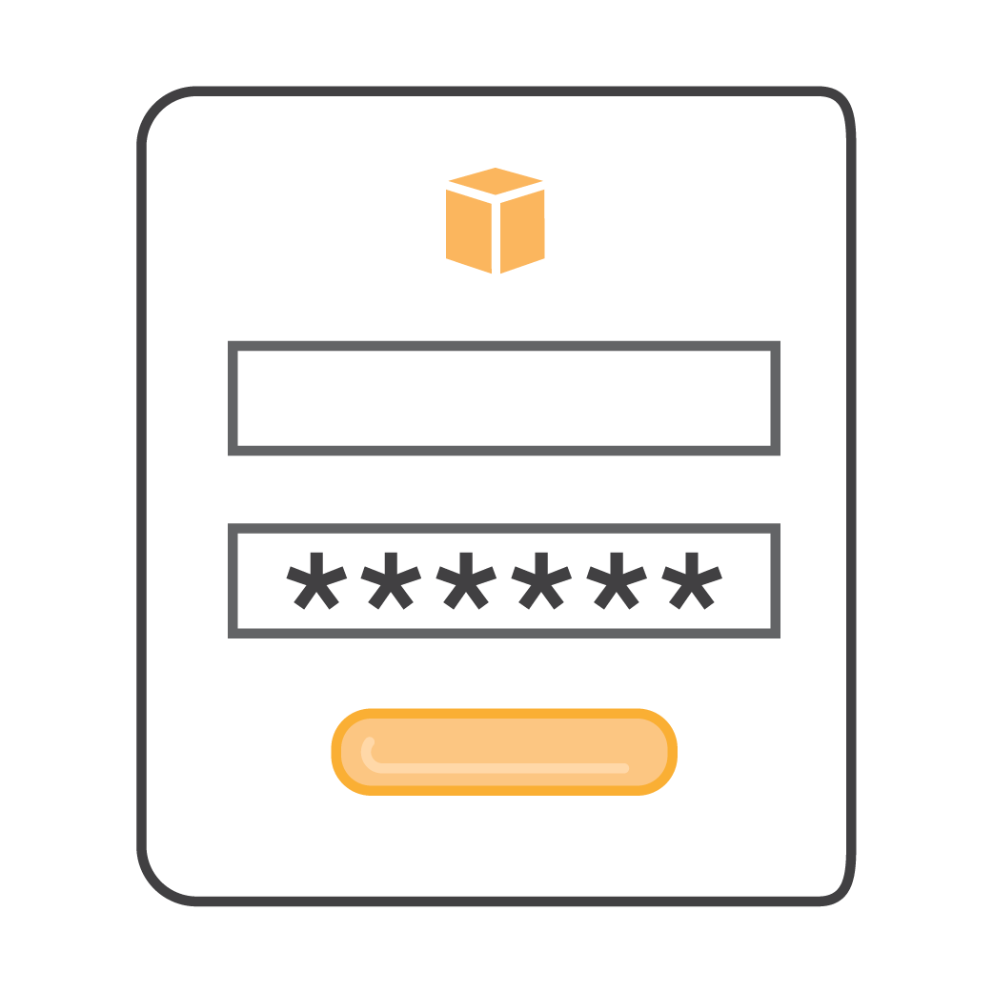

Multi-factor authentication (MFA)
With MFA, users must supply both a password and a one-time challenge/response token.
Types of MFA
Hardware (Gemalto, YubiKey)
Virtual (e.g., Authy, Google Authenticator)
MFA Token device is device is synchronized with your AWS or IAM account.

Slide 13
Manage Multiple Account- AWS Organizations
AWS
Organization
Policy
Root
Policy
Policy
Policy
OU
OU
AWS
account
OU
OU
AWS
account
AWS
account
AWS
account
AWS
account
AWS
account
AWS
account

Slide 14
AWS Security Token Service
AWS (Service Provider)
Corporate Data Center
AWS API
AWS Services
Session
Access Key ID
Secret Access Key
Session Token
Expiration
AWS STS
Temporary Security Credentials
15 minutes to 36 hours

Slide 15







Encryption
Client-side encryption
You encrypt your data before data submitted to service
You supply encryption keys or use keys in your AWS account
Server-side encryption
AWS encrypts data on your behalf after data is received by service
AWS Key Management Service
AWS CloudHSM
Key is generated from either software or hardware device
Key is used to encrypt data along with an encryption algorithm (e.g., AES)
Hardware/ software
Symmetric data key
Plain-text data
Encrypted data
Encrypted data in storage
You don’t want to store the key with the encrypted data!
?
Symmetric data key
Master key
Encrypted data key
Key encryption key

Slide 16
AWS KMS
Fully managed and centralized service for creating, protecting, and enforcing encryption keys
AWS Key Management Service (AWS KMS) uses FIPS 140-2 validated hardware security modules (HSMs) to generate and protect keys
Certified under multiple compliance schemes to simplify your own compliance obligations
AWS KMS

Slide 17




AWS CERTIFICATE manager
Elastic Load Balancing
AWS Certificate Manager
ACM certificate
Developer
API Gateway
CloudFront Distribution

Slide 18




AWS Secrets Manager
Rotate, manage, and retrieve database credentials, API keys, and other secrets throughout their lifecycle.
Your Code
Authorized call to Secrets Manager
AWS resources
DB creds
loaded
DB creds returned
EC2 instance
Connection established
AWS credentials via IAM roles
Safe rotation
Other resources

Slide 19
WAF & shield
WAF
AWS WAF is a web application firewall that helps protect your web applications
Increased protection from web attacks
Integrated security with other AWS services
Improved web traffic visibility
Enhanced security with managed rules
AWS WAF
Shield
All AWS customers are protected by AWS Shield at no additional cost
Defends against most network and transport layer attacks
For additional security, you can subscribe to AWS Shield Advanced
AWS Shield

Slide 20
AWS WAF Conditions
Condition | Allow or Block Requests Based On…
Cross-site scripting match | Whether the requests appear to contain malicious scripts
IP match | The IP addresses that they originate from
Geographic match | The country that they originate from
Size constraint | Whether the requests exceed a specified length
SQL injection match | Whether the requests appear to contain malicious SQL code
String match | Strings that appear in the requests
Regex match | A regex pattern that appears in the requests

Slide 21
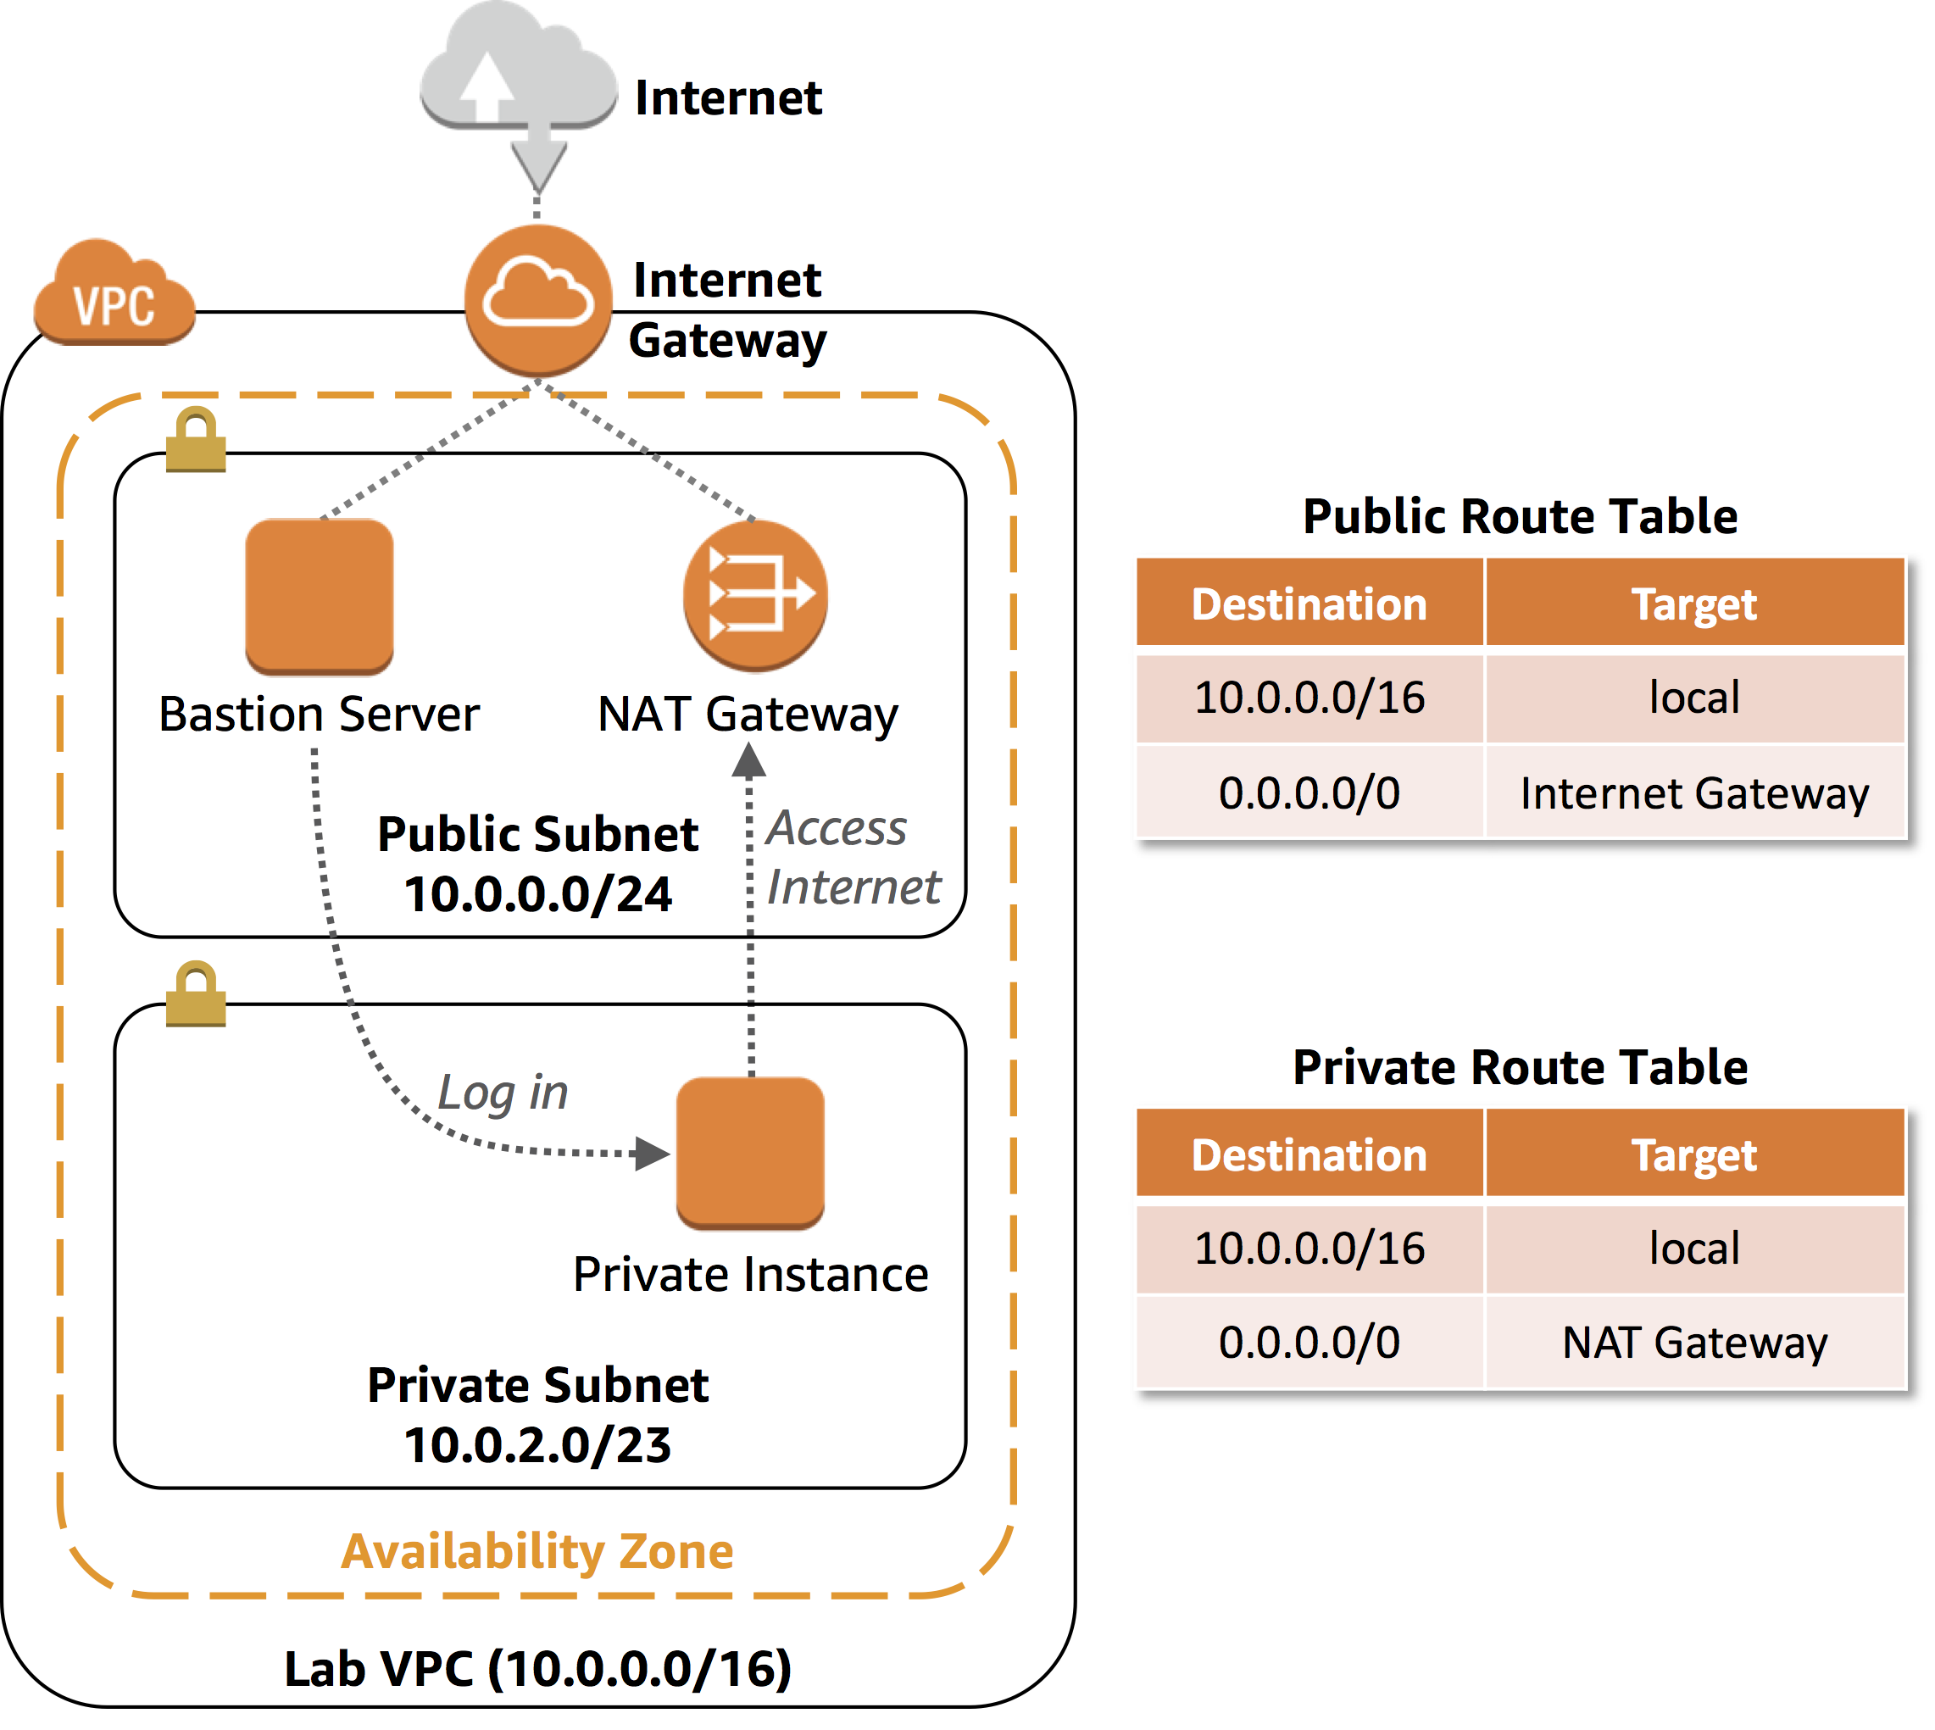
Introduction to VPC
A VPC is a virtual network dedicated to your AWS account
Exists either in the IPv4 or IPv6 address ranges
Enables you to create specific CIDR ranges for your resources to occupy
Provides strict access rules for inbound and outbound traffic.
Major Components of VPC
Subnet (Public and Private Subnet)
Internet Gateway
NAT Gateway
Route Table
VPN
Security Group
NACL

Slide 22


VPC-Peering
Dev
PCX-1
Prod
VPC
Instances can communicate across a peering connection as if they were in the same network.
Use private IP addresses
Intra- and inter-region support
IP spaces cannot overlap
Only one peering resource between any two VPCs
Transitive peering relationships are not supported
Can be established between different AWS accounts
Dev
10.1.0.0/16
VPC peering
10.2.0.0/16
10.1.0.0/16
A
B
Route table
Test
Destination | Target
10.1.0.0/16 | local
10.2.0.0/16 | PCX-1
A
10.2.0.0/16
Route table
Prod
Destination | Target
10.2.0.0/16 | local
10.1.0.0/16 | PCX-1
B
10.3.0.0/16

Slide 23








AWS VPN
To establish private connections between an Amazon VPC and another network
Virtual private gateway links to your Amazon VPC
A customer gateway is the anchor on your side of that connection (on premises)
Public internet
VPC
Two endpoints
Availability Zone A
Availability Zone B
Corporate data center
Customer gateway
Public subnet
Public subnet
VGW
VPN connection

Slide 24
Sample Questions
A Development team are developing a micro-services application that will use Docker containers on Amazon
ECS. There will be 6 distinct services included in the architecture. Each service requires specific permissions
to various AWS services. What is the MOST secure way to grant the services the necessary permissions?
1: Create a new Identity and Access Management (IAM) instance profile containing the required permissions
for the various ECS services, then associate that instance role with the underlying EC2 instances
2: Create six separate IAM roles, each containing the required permissions for the associated ECS service, then
configure each ECS task definition to reference the associated IAM role
3: Create six separate IAM roles, each containing the required permissions for the associated ECS service, then
create an IAM group and configure the ECS cluster to reference that group
4: Create a single IAM policy and use principal statements referencing the ECS tasks and assigning the required
permissions, then apply the policy to the ECS service

Slide 25
Sample Questions
A Development team are developing a micro-services application that will use Docker containers on Amazon
ECS. There will be 6 distinct services included in the architecture. Each service requires specific permissions
to various AWS services. What is the MOST secure way to grant the services the necessary permissions?
1: Create a new Identity and Access Management (IAM) instance profile containing the required permissions
for the various ECS services, then associate that instance role with the underlying EC2 instances
2: Create six separate IAM roles, each containing the required permissions for the associated ECS service, then configure each ECS task definition to reference the associated IAM role
3: Create six separate IAM roles, each containing the required permissions for the associated ECS service, then
create an IAM group and configure the ECS cluster to reference that group
4: Create a single IAM policy and use principal statements referencing the ECS tasks and assigning the required
permissions, then apply the policy to the ECS service

Slide 26
Sample Questions
A company is reviewing their security practices. According to AWS best practice, how should access keys be
managed to improve security? (Select TWO)
1: Delete all access keys for the root account IAM user
2: Embed access keys directly into code
3: Rotate access keys daily
4: Use different access keys for different applications
5: Use the same access key in all applications for consistency

Slide 27
Sample Questions
A company is reviewing their security practices. According to AWS best practice, how should access keys be
managed to improve security? (Select TWO)
1: Delete all access keys for the root account IAM user
2: Embed access keys directly into code
3: Rotate access keys daily
4: Use different access keys for different applications
5: Use the same access key in all applications for consistency

Slide 28
Sample Questions
A mobile application has thousands of users. Each user may use multiple devices to access the application.
The Developer wants to assign unique identifiers to these users regardless of the device they use. Which of
the below is the BEST method to obtain unique identifiers?
1: Create a user table in Amazon DynamoDB with key-value pairs of users and their devices. Use these keys as
unique identifiers
2: Use IAM-generated access key IDs for the users as the unique identifier, but do not store secret keys
3: Implement developer-authenticated identities by using Amazon Cognito and get credentials for these
identities
4: Assign IAM users and roles to the users. Use the unique IAM resource ID as the unique identifier

Slide 29
Sample Questions
A mobile application has thousands of users. Each user may use multiple devices to access the application.
The Developer wants to assign unique identifiers to these users regardless of the device they use. Which of
the below is the BEST method to obtain unique identifiers?
1: Create a user table in Amazon DynamoDB with key-value pairs of users and their devices. Use these keys as
unique identifiers
2: Use IAM-generated access key IDs for the users as the unique identifier, but do not store secret keys
3: Implement developer-authenticated identities by using Amazon Cognito and get credentials for these
identities
4: Assign IAM users and roles to the users. Use the unique IAM resource ID as the unique identifier

Slide 30
Sample Questions
A Developer has code running on Amazon EC2 instances that needs read-only access to an Amazon
DynamoDB table. What is the MOST secure approach the Developer should take to accomplish this task?
1: Create a user access key for each EC2 instance with read-only access to DynamoDB. Place the keys in the
code. Redeploy the code as keys rotate
2: Use an IAM role with an AmazonDynamoDBReadOnlyAccess policy applied to the EC2 instances
3: Run all code with only AWS account root user access keys to ensure maximum access to services
4: Use an IAM role with Administrator access applied to the EC2 instance

Slide 31
Sample Questions
A Developer has code running on Amazon EC2 instances that needs read-only access to an Amazon
DynamoDB table. What is the MOST secure approach the Developer should take to accomplish this task?
1: Create a user access key for each EC2 instance with read-only access to DynamoDB. Place the keys in the
code. Redeploy the code as keys rotate
2: Use an IAM role with an AmazonDynamoDBReadOnlyAccess policy applied to the EC2 instances
3: Run all code with only AWS account root user access keys to ensure maximum access to services
4: Use an IAM role with Administrator access applied to the EC2 instance

Slide 32
Sample Questions
A customer-facing web application runs on Amazon EC2 with an Application Load Balancer and an Amazon
RDS database back end. Recently, the security team noticed some SQL injection attacks and cross-site scripting attacks targeting the web application. Which service can a Developer use to protect against future
attacks?
1: Security Groups
2: Network ACLs
3: AWS WAF
4: AWS KMS

Slide 33
Sample Questions
A customer-facing web application runs on Amazon EC2 with an Application Load Balancer and an Amazon
RDS database back end. Recently, the security team noticed some SQL injection attacks and cross-site scripting attacks targeting the web application. Which service can a Developer use to protect against future
attacks?
1: Security Groups
2: Network ACLs
3: AWS WAF
4: AWS KMS

Slide 34
Sample Questions
An application uses Amazon EC2, and Application Load Balancer and Amazon CloudFront to serve content.
The security team have reported malicious activity from a specific range of IP addresses. How can a
Developer prevent the application from being targeted by these addresses again?
1: Create a security group rule denying the address range and apply it to the EC2 instances
2: Add a certificate using AWS Certificate Manager (ACM) and encrypt all communications
3: Add a rule to a Web ACL using AWS WAF that denies the IP address ranges
4: Disable the Amazon CloudFront distribution and then reenable it

Slide 35
Sample Questions
An application uses Amazon EC2, and Application Load Balancer and Amazon CloudFront to serve content.
The security team have reported malicious activity from a specific range of IP addresses. How can a
Developer prevent the application from being targeted by these addresses again?
1: Create a security group rule denying the address range and apply it to the EC2 instances
2: Add a certificate using AWS Certificate Manager (ACM) and encrypt all communications
3: Add a rule to a Web ACL using AWS WAF that denies the IP address ranges
4: Disable the Amazon CloudFront distribution and then reenable it

Slide 36
Sample Questions
In reference to AWS IAM Decision Logic, what is the first step when determining access permissions for any resource in AWS? Choose the correct answer from the options below:
a. An explicit "deny"
b. A default "allow"
c. An explicit "allow"
d. A default "deny"

Slide 37
Sample Questions
In reference to AWS IAM Decision Logic, what is the first step when determining access permissions for any resource in AWS? Choose the correct answer from the options below:
a. An explicit "deny"
b. A default "allow"
c. An explicit "allow"
d. A default "deny"

Slide 38
Sample Questions
In reference to AWS IAM Decision Logic, what is the first step when determining access permissions for any resource in AWS? Choose the correct answer from the options below:
a. An explicit "deny"
b. A default "allow"
c. An explicit "allow"
d. A default "deny"

Slide 39
Sample Questions
A company has released a new application on AWS. The company are concerned about security and require
a tool that can automatically assess applications for exposure, vulnerabilities, and deviations from best
practices. Which AWS service should they use?
1: Amazon Inspector
2: AWS Shield
3: AWS WAF
4: AWS Secrets Manager

Slide 40
Sample Questions
A company has released a new application on AWS. The company are concerned about security and require
a tool that can automatically assess applications for exposure, vulnerabilities, and deviations from best
practices. Which AWS service should they use?
1: Amazon Inspector
2: AWS Shield
3: AWS WAF
4: AWS Secrets Manager

Slide 41
Sample Questions
Your mobile application includes a photo-sharing service that is expecting tens of thousands of users at launch. You will leverage Amazon Simple Storage Service (S3) for storage of the user Images, and you must decide how to authenticate and authorize your users for access to these images. You also need to manage the storage of these images. Which two of the following approaches should you use?
a. Create an Amazon S3 bucket per user, and use your application to generate the S3 URL for the appropriate content.
b. Use AWS Identity and Access Management (IAM) user accounts as your application-level user database, and offload the burden of authentication from your application code.
c. Authenticate your users at the application level, and use AWS Security Token Service (STS)to grant token-based authorization to S3 objects.
d. Authenticate your users at the application level, and send an SMS token message to the user. Create an Amazon S3 bucket with the same name as the SMS message token, and move the user’s objects to that bucket.

Slide 42
Sample Questions
Your mobile application includes a photo-sharing service that is expecting tens of thousands of users at launch. You will leverage Amazon Simple Storage Service (S3) for storage of the user Images, and you must decide how to authenticate and authorize your users for access to these images. You also need to manage the storage of these images. Which two of the following approaches should you use?
a. Create an Amazon S3 bucket per user, and use your application to generate the S3 URL for the appropriate content.
b. Use AWS Identity and Access Management (IAM) user accounts as your application-level user database, and offload the burden of authentication from your application code.
c. Authenticate your users at the application level, and use AWS Security Token Service (STS)to grant token-based authorization to S3 objects.
d. Authenticate your users at the application level, and send an SMS token message to the user. Create an Amazon S3 bucket with the same name as the SMS message token, and move the user’s objects to that bucket.

Slide 43
Sample Questions
Your mobile application includes a photo-sharing service that is expecting tens of thousands of users at launch. You will leverage Amazon Simple Storage Service (S3) for storage of the user Images, and you must decide how to authenticate and authorize your users for access to these images. You also need to manage the storage of these images. Which two of the following approaches should you use?
a. Create an Amazon S3 bucket per user, and use your application to generate the S3 URL for the appropriate content.
b. Use AWS Identity and Access Management (IAM) user accounts as your application-level user database, and offload the burden of authentication from your application code.
c. Authenticate your users at the application level, and use AWS Security Token Service (STS)to grant token-based authorization to S3 objects.
d. Authenticate your users at the application level, and send an SMS token message to the user. Create an Amazon S3 bucket with the same name as the SMS message token, and move the user’s objects to that bucket.

Slide 44
Sample Questions
Your company has developed a web application and is hosting it in an Amazon S3 bucket configured for static website hosting. The users can log in to this app using their Google/Facebook login accounts. The application is using the AWS SDK for JavaScript in the browser to access data stored in an Amazon DynamoDB table. How can you ensure that API keys for access to your data in DynamoDB are kept secure?
a. Create an Amazon S3 role in IAM with access to the specific DynamoDB tables, and assign it to the bucket hosting your website.
b. Configure S3 bucket tags with your AWS access keys for your bucket hosing your website so that the application can query them for access.
c. Configure a web identity federation role within IAM to enable access to the correct DynamoDB resources and retrieve temporary credentials.
d. Store AWS keys in global variables within your application and configure the application to use these credentials when making requests.

Slide 45
Sample Questions
Your company has developed a web application and is hosting it in an Amazon S3 bucket configured for static website hosting. The users can log in to this app using their Google/Facebook login accounts. The application is using the AWS SDK for JavaScript in the browser to access data stored in an Amazon DynamoDB table. How can you ensure that API keys for access to your data in DynamoDB are kept secure?
a. Create an Amazon S3 role in IAM with access to the specific DynamoDB tables, and assign it to the bucket hosting your website.
b. Configure S3 bucket tags with your AWS access keys for your bucket hosing your website so that the application can query them for access.
c. Configure a web identity federation role within IAM to enable access to the correct DynamoDB resources and retrieve temporary credentials.
d. Store AWS keys in global variables within your application and configure the application to use these credentials when making requests.

Slide 46
Sample Questions
Your company has developed a web application and is hosting it in an Amazon S3 bucket configured for static website hosting. The users can log in to this app using their Google/Facebook login accounts. The application is using the AWS SDK for JavaScript in the browser to access data stored in an Amazon DynamoDB table. How can you ensure that API keys for access to your data in DynamoDB are kept secure?
a. Create an Amazon S3 role in IAM with access to the specific DynamoDB tables, and assign it to the bucket hosting your website.
b. Configure S3 bucket tags with your AWS access keys for your bucket hosing your website so that the application can query them for access.
c. Configure a web identity federation role within IAM to enable access to the correct DynamoDB resources and retrieve temporary credentials.
d. Store AWS keys in global variables within your application and configure the application to use these credentials when making requests.

Slide 47
Sample Questions
You are using AWS DynamoDB as a database to save sales data for a global appliance company. All data at rest is encrypted using AWS KMS. Which of the following can be used for encryption of global secondary indexes with minimum cost ?
a. Data Keys with AWS Managed CMK.
b. Table Keys with AWS Managed CMK.
c. Table Keys with AWS owned CMK.
d. Data Keys with AWS owned CMK

Slide 48
Sample Questions
You are using AWS DynamoDB as a database to save sales data for a global appliance company. All data at rest is encrypted using AWS KMS. Which of the following can be used for encryption of global secondary indexes with minimum cost ?
a. Data Keys with AWS Managed CMK.
b. Table Keys with AWS Managed CMK.
c. Table Keys with AWS owned CMK.
d. Data Keys with AWS owned CMK

Slide 49
Sample Questions
You are using AWS DynamoDB as a database to save sales data for a global appliance company. All data at rest is encrypted using AWS KMS. Which of the following can be used for encryption of global secondary indexes with minimum cost ?
a. Data Keys with AWS Managed CMK.
b. Table Keys with AWS Managed CMK.
c. Table Keys with AWS owned CMK.
d. Data Keys with AWS owned CMK

Slide 50
Sample Questions
Your team has completed the development of an application and now this needs to be deployed to an application on an EC2 Instance. The Application data will be stored on a separate volume which needs to be encrypted at rest. How can you ensure this requirement is met?
a. Ensure that Encryption is enabled during volume creation time.
b. Ensure to use Throughput Optimized HDD to allow for Encryption
c. Create a Customer master key in the KMS service
d. Create an EBS Encryption Key

Slide 51
Sample Questions
Your team has completed the development of an application and now this needs to be deployed to an application on an EC2 Instance. The Application data will be stored on a separate volume which needs to be encrypted at rest. How can you ensure this requirement is met?
a. Ensure that Encryption is enabled during volume creation time.
b. Ensure to use Throughput Optimized HDD to allow for Encryption
c. Create a Customer master key in the KMS service
d. Create an EBS Encryption Key

Slide 52
Sample Questions
Your team has completed the development of an application and now this needs to be deployed to an application on an EC2 Instance. The Application data will be stored on a separate volume which needs to be encrypted at rest. How can you ensure this requirement is met?
a. Ensure that Encryption is enabled during volume creation time.
b. Ensure to use Throughput Optimized HDD to allow for Encryption
c. Create a Customer master key in the KMS service
d. Create an EBS Encryption Key

Slide 53
Sample Questions
Your company has a development application that needs to interact with an S3 bucket. There is a requirement that all data in the bucket is encrypted at rest. You also need to ensure that the keys are managed by you. Which of the following can you use for this purpose? Choose 3 answers from the options given below
a. Server-Side Encryption with AWS Managed Keys
b. Server-Side Encryption with AWS KMS Keys
c. Server-Side Encryption with Customer-Provided Keys
d. Client-Side Encryption

Slide 54
Sample Questions
Your company has a development application that needs to interact with an S3 bucket. There is a requirement that all data in the bucket is encrypted at rest. You also need to ensure that the keys are managed by you. Which of the following can you use for this purpose? Choose 3 answers from the options given below
a. Server-Side Encryption with AWS Managed Keys
b. Server-Side Encryption with AWS KMS Keys
c. Server-Side Encryption with Customer-Provided Keys
d. Client-Side Encryption

Slide 55
Sample Questions
Your company has a development application that needs to interact with an S3 bucket. There is a requirement that all data in the bucket is encrypted at rest. You also need to ensure that the keys are managed by you. Which of the following can you use for this purpose? Choose 3 answers from the options given below
a. Server-Side Encryption with AWS Managed Keys
b. Server-Side Encryption with AWS KMS Keys
c. Server-Side Encryption with Customer-Provided Keys
d. Client-Side Encryption

Slide 56
Sample Questions
Your team is deploying a set of applications on to AWS. These applications work with multiple databases. You need to ensure that the database passwords are stored securely. Which of the following is the ideal way to store the database passwords?
a. Store them in separate Lambda functions which can be invoked via HTTPS
b. Store them as secrets in AWS Secrets Manager
c. Store them in separate DynamoDB tables
d. Store them in separate S3 buckets

Slide 57
Sample Questions
Your team is deploying a set of applications on to AWS. These applications work with multiple databases. You need to ensure that the database passwords are stored securely. Which of the following is the ideal way to store the database passwords?
a. Store them in separate Lambda functions which can be invoked via HTTPS
b. Store them as secrets in AWS Secrets Manager
c. Store them in separate DynamoDB tables
d. Store them in separate S3 buckets

Slide 58
Sample Questions
Your team is deploying a set of applications on to AWS. These applications work with multiple databases. You need to ensure that the database passwords are stored securely. Which of the following is the ideal way to store the database passwords?
a. Store them in separate Lambda functions which can be invoked via HTTPS
b. Store them as secrets in AWS Secrets Manager
c. Store them in separate DynamoDB tables
d. Store them in separate S3 buckets

Slide 59
Sample Questions
You have created REST API using API Gateway. Which of the following mechanism can be used to deny specific IP Address from accessing API Gateway?
a. AWS KMS
b. AWS Security Center
c. Resource Policies
d. AWS WAF

Slide 60
Sample Questions
You have created REST API using API Gateway. Which of the following mechanism can be used to deny specific IP Address from accessing API Gateway?
a. AWS KMS
b. AWS Security Center
c. Resource Policies
d. AWS WAF

Slide 61
Sample Questions
You have created REST API using API Gateway. Which of the following mechanism can be used to deny specific IP Address from accessing API Gateway?
a. AWS KMS
b. AWS Security Center
c. Resource Policies
d. AWS WAF

Slide 62
Sample Questions
You have created a VPC that has the default subnet with an internet gateway attached and required route table entry set. Which of the following is true with regards to the connection of an EC2 instance located in the VPC?
Choose the correct answer from the options below.
a. It does not need a NAT instance or an EIP to communicate with the internet.
b. The EC2 instance can connect to the internet using the EIP or public IP assigned to it
c. None of the above
d. It can connect.

Slide 63
Sample Questions
You have created a VPC that has the default subnet with an internet gateway attached and required route table entry set. Which of the following is true with regards to the connection of an EC2 instance located in the VPC?
Choose the correct answer from the options below.
a. It does not need a NAT instance or an EIP to communicate with the internet.
b. The EC2 instance can connect to the internet using the EIP or public IP assigned to it
c. None of the above
d. It can connect.

Slide 64
Sample Questions
You have created a VPC that has the default subnet with an internet gateway attached and required route table entry set. Which of the following is true with regards to the connection of an EC2 instance located in the VPC?
Choose the correct answer from the options below.
a. It does not need a NAT instance or an EIP to communicate with the internet.
b. The EC2 instance can connect to the internet using the EIP or public IP assigned to it
c. None of the above
d. It can connect.

Slide 65
Sample Questions
Someone on your team configured a Virtual Private Cloud with two public subnets in two separate AZs and two private subnets in two separate AZs. Each public subnet AZ has a matching private subnet AZ. The VPC and its subnets are properly configured. You also notice that there are multiple web server instances in the private subnet, and you've been charged with setting up a public-facing Elastic Load Balancer which will accept requests from clients and distribute those requests to the web server instances. How can you set this up? Choose the correct answer from the options below
a. Associate one public subnet and one private subnet which contain the web server instances with the ELB when configuring the ELB
b. Associate both the public subnets with the ELB when configuring the ELB
c. You can't. Web server instances must be in public subnets in order for this to work
d. Associate both the private subnets which contain the web server instances with the ELB when configuring the ELB

Slide 66
Sample Questions
Someone on your team configured a Virtual Private Cloud with two public subnets in two separate AZs and two private subnets in two separate AZs. Each public subnet AZ has a matching private subnet AZ. The VPC and its subnets are properly configured. You also notice that there are multiple web server instances in the private subnet, and you've been charged with setting up a public-facing Elastic Load Balancer which will accept requests from clients and distribute those requests to the web server instances. How can you set this up? Choose the correct answer from the options below
a. Associate one public subnet and one private subnet which contain the web server instances with the ELB when configuring the ELB
b. Associate both the public subnets with the ELB when configuring the ELB
c. You can't. Web server instances must be in public subnets in order for this to work
d. Associate both the private subnets which contain the web server instances with the ELB when configuring the ELB

Slide 67
Sample Questions
Someone on your team configured a Virtual Private Cloud with two public subnets in two separate AZs and two private subnets in two separate AZs. Each public subnet AZ has a matching private subnet AZ. The VPC and its subnets are properly configured. You also notice that there are multiple web server instances in the private subnet, and you've been charged with setting up a public-facing Elastic Load Balancer which will accept requests from clients and distribute those requests to the web server instances. How can you set this up? Choose the correct answer from the options below
a. Associate one public subnet and one private subnet which contain the web server instances with the ELB when configuring the ELB
b. Associate both the public subnets with the ELB when configuring the ELB
c. You can't. Web server instances must be in public subnets in order for this to work
d. Associate both the private subnets which contain the web server instances with the ELB when configuring the ELB

Slide 68
Happy Learning!!
68

